Slide 1


Pseudo-collusion due to algorithmic pricing with transient demand response
Lukasz Sliwinski, David Siska
University of Edinburgh
2024 Conference on Mechanism and Institution Design in Budapest

Slide 2
Background - algorithmic pricing
More and more decisions are made by algorithms:
  high-frequency trading (Seth 2023)
  online retail e.g. Amazon (Rathore 2022)
  taxi service e.g. Uber (Singh 2024)
  fast food e.g. Wendy's (Foroohar 2024)

Slide 3
Background - algorithmic pricing
More and more decisions are made by algorithms:
  high-frequency trading (Seth 2023)
  online retail e.g. Amazon (Rathore 2022)
  taxi service e.g. Uber (Singh 2024)
  fast food e.g. Wendy's (Foroohar 2024)
In theory: benefits for both the seller and the buyer.

Slide 4
Background - algorithmic pricing
More and more decisions are made by algorithms:
  high-frequency trading (Seth 2023)
  online retail e.g. Amazon (Rathore 2022)
  taxi service e.g. Uber (Singh 2024)
  fast food e.g. Wendy's (Foroohar 2024)
In theory: benefits for both the seller and the buyer.
In practice: behaviour and impact of algorithmic pricing is difficult to predict.

Slide 5
Background - collusion
Assad et al. 2020 inspected real data from gas station sales and linked introduction of algorithmic pricing with higher gas prices
(increases ranging from 9% to 28%).

Slide 6
Background - collusion
Assad et al. 2020 inspected real data from gas station sales and linked introduction of algorithmic pricing with higher gas prices
(increases ranging from 9% to 28%)
Calvano et al. 2020 presented numerical experiments in which
Q-learning algorithms converged to tacit collusion:
Equilibrium in which one agent punishes the other for deviations from supracompetitive pricing.

Slide 7
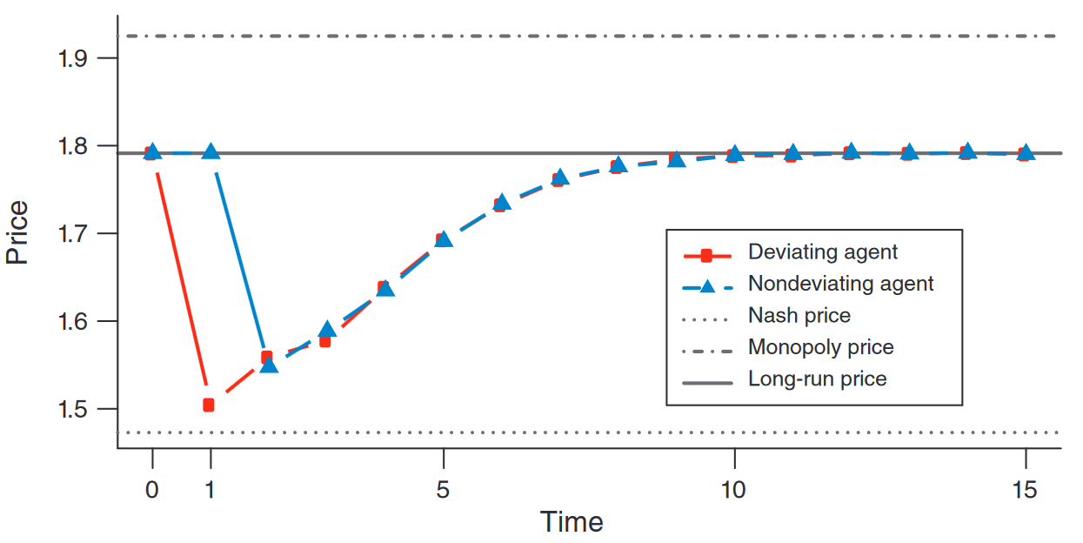
Background - collusion
Calvano et al. - punishment scheme

Slide 8
Questions
Can there be collusion without the possiblity of punishing the opponents?

Slide 9
Questions
Can there be collusion without the possiblity of punishing the opponents?
What factors could potentially contribute to price increases due to algorithmic pricing?

Slide 10
This work
Numerical simulations of pricing competitions between learning agents (similarily to Calvano et al. 2020).

Slide 11
This work
Numerical simulations of pricing competitions between learning agents (similarily to Calvano et al. 2020).
Learning algorithm is a multi-armed-bandit (MAB) algorithm:
  can't observe the prices of competitors,
  no explicit punishment scheme.

Slide 12
This work
Numerical simulations of pricing competitions between learning agents (similarily to Calvano et al. 2020).
Learning algorithm is a multi-armed-bandit (MAB) algorithm:
  can't observe the prices of competitors,
  no explicit punishment scheme.
Learning algorithm's exploration is localised:
  → no high variations in price over time.

Slide 13
This work
Numerical simulations of pricing competitions between learning agents (similarily to Calvano et al. 2020).
Learning algorithm is a multi-armed-bandit (MAB) algorithm:
  can't observe the prices of competitors,
  no explicit punishment scheme.
Learning algorithm's exploration is localised:
  → no high variations in price over time.
Learning algorithm is non-stationary:
  → adapts if the environment changes.

Slide 14
This work
The environment allows for transient/delayed demand response:
When the prices change, the experienced demand does not converge immediately to the true "long running" demand, but does so over time.

Slide 15
This work
The environment allows for transient/delayed demand response:
When the prices change, the experienced demand does not converge immediately to the true "long running" demand, but does so over time.
For example, if a gas station increases the gas price, normally we will accept it until we realise the price in unfair.

Slide 16
This work - key findings
1. Even without transient demand response, autonomous agents that cannot observe the competitor prices can converge to supra-competitive equilibrium.

Slide 17
This work - key findings
1. Even without transient demand response, autonomous agents that cannot observe the competitor prices can converge to supra-competitive equilibrium.
2. When the transient demand response is introduced into the environment, the product margins can increase by 40% with respect to the competitive levels.

Slide 18
Outline
Environment.
Delayed demand response.
Learning algorithm.
Results.

Slide 19
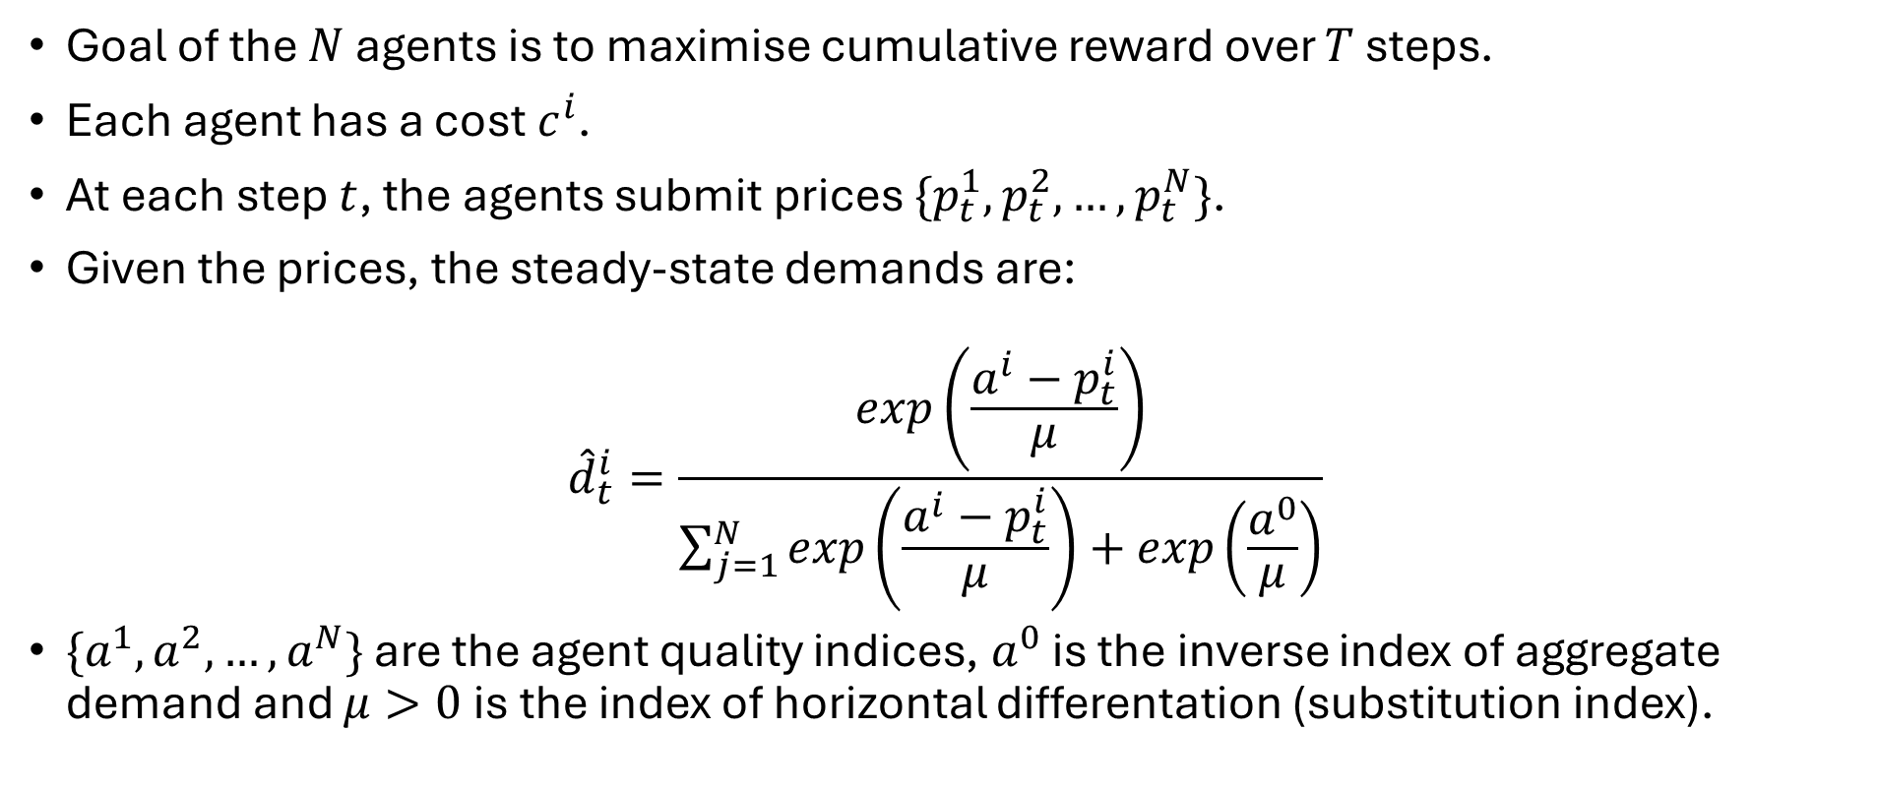
Environment
Goal of the $N$ agents is to maximise cumulative reward over $T$ steps.
Each agent has a cost $c^{i}$.
At each step $t$, the agents submit prices $\{p_{t}^{1}, p_{t}^{2},…,p_{t}^{N}\}$.
Given the prices, the steady-state demands are:
$${\hat{d}}_{t}^{i}=\frac{exp\left(\frac{a^{i}−p_{t}^{i}}{μ}\right)}{\sum_{j=1}^{N}{exp\left(\frac{a^{i}−p_{t}^{i}}{μ}\right)+exp\left(\frac{a^{0}}{μ}\right)}}$$
$\{a^{1},a^{2},…,a^{N}\}$ are the agent quality indices, $a^{0}$ is the inverse index of aggregate demand and $μ>0$ is the index of horizontal differentation (substitution index).

Slide 20
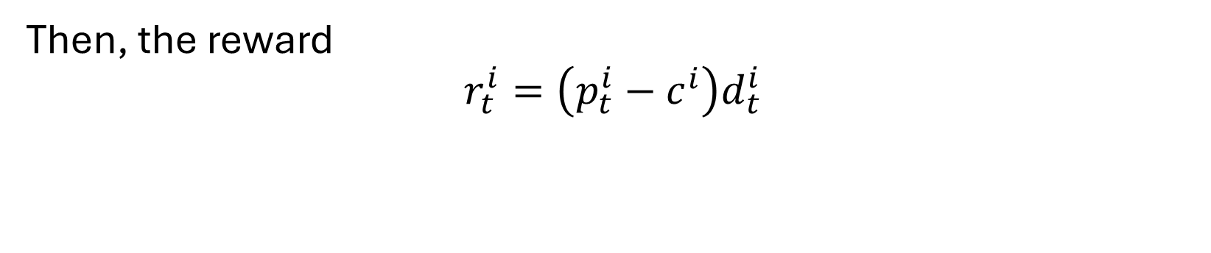
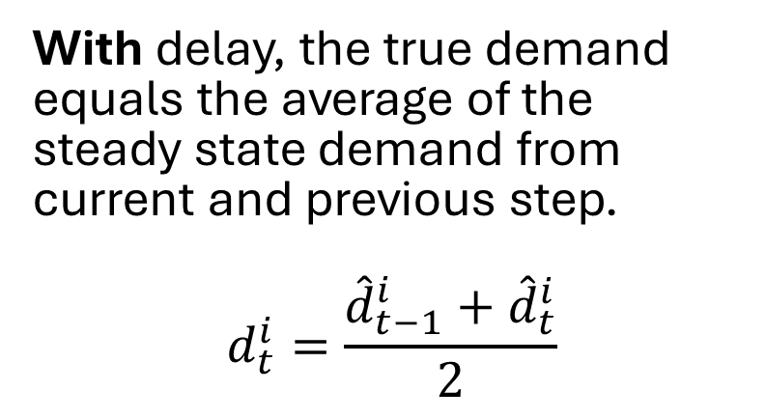
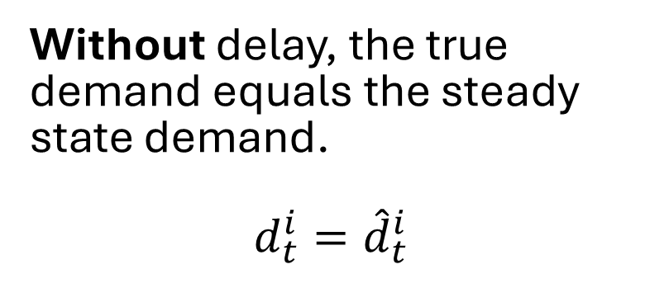
Environment - delay mechanism
Without delay, the true demand equals the steady state demand.
$$d_{t}^{i}={\hat{d}}_{t}^{i}$$
With delay, the true demand equals the average of the steady state demand from current and previous step.
$$d_{t}^{i}=\frac{{\hat{d}}_{t−1}^{i}+{\hat{d}}_{t}^{i}}{2}$$
Then, the reward
$$r_{t}^{i}=\left(p_{t}^{i}−c^{i}\right)d_{t}^{i}$$

Slide 21
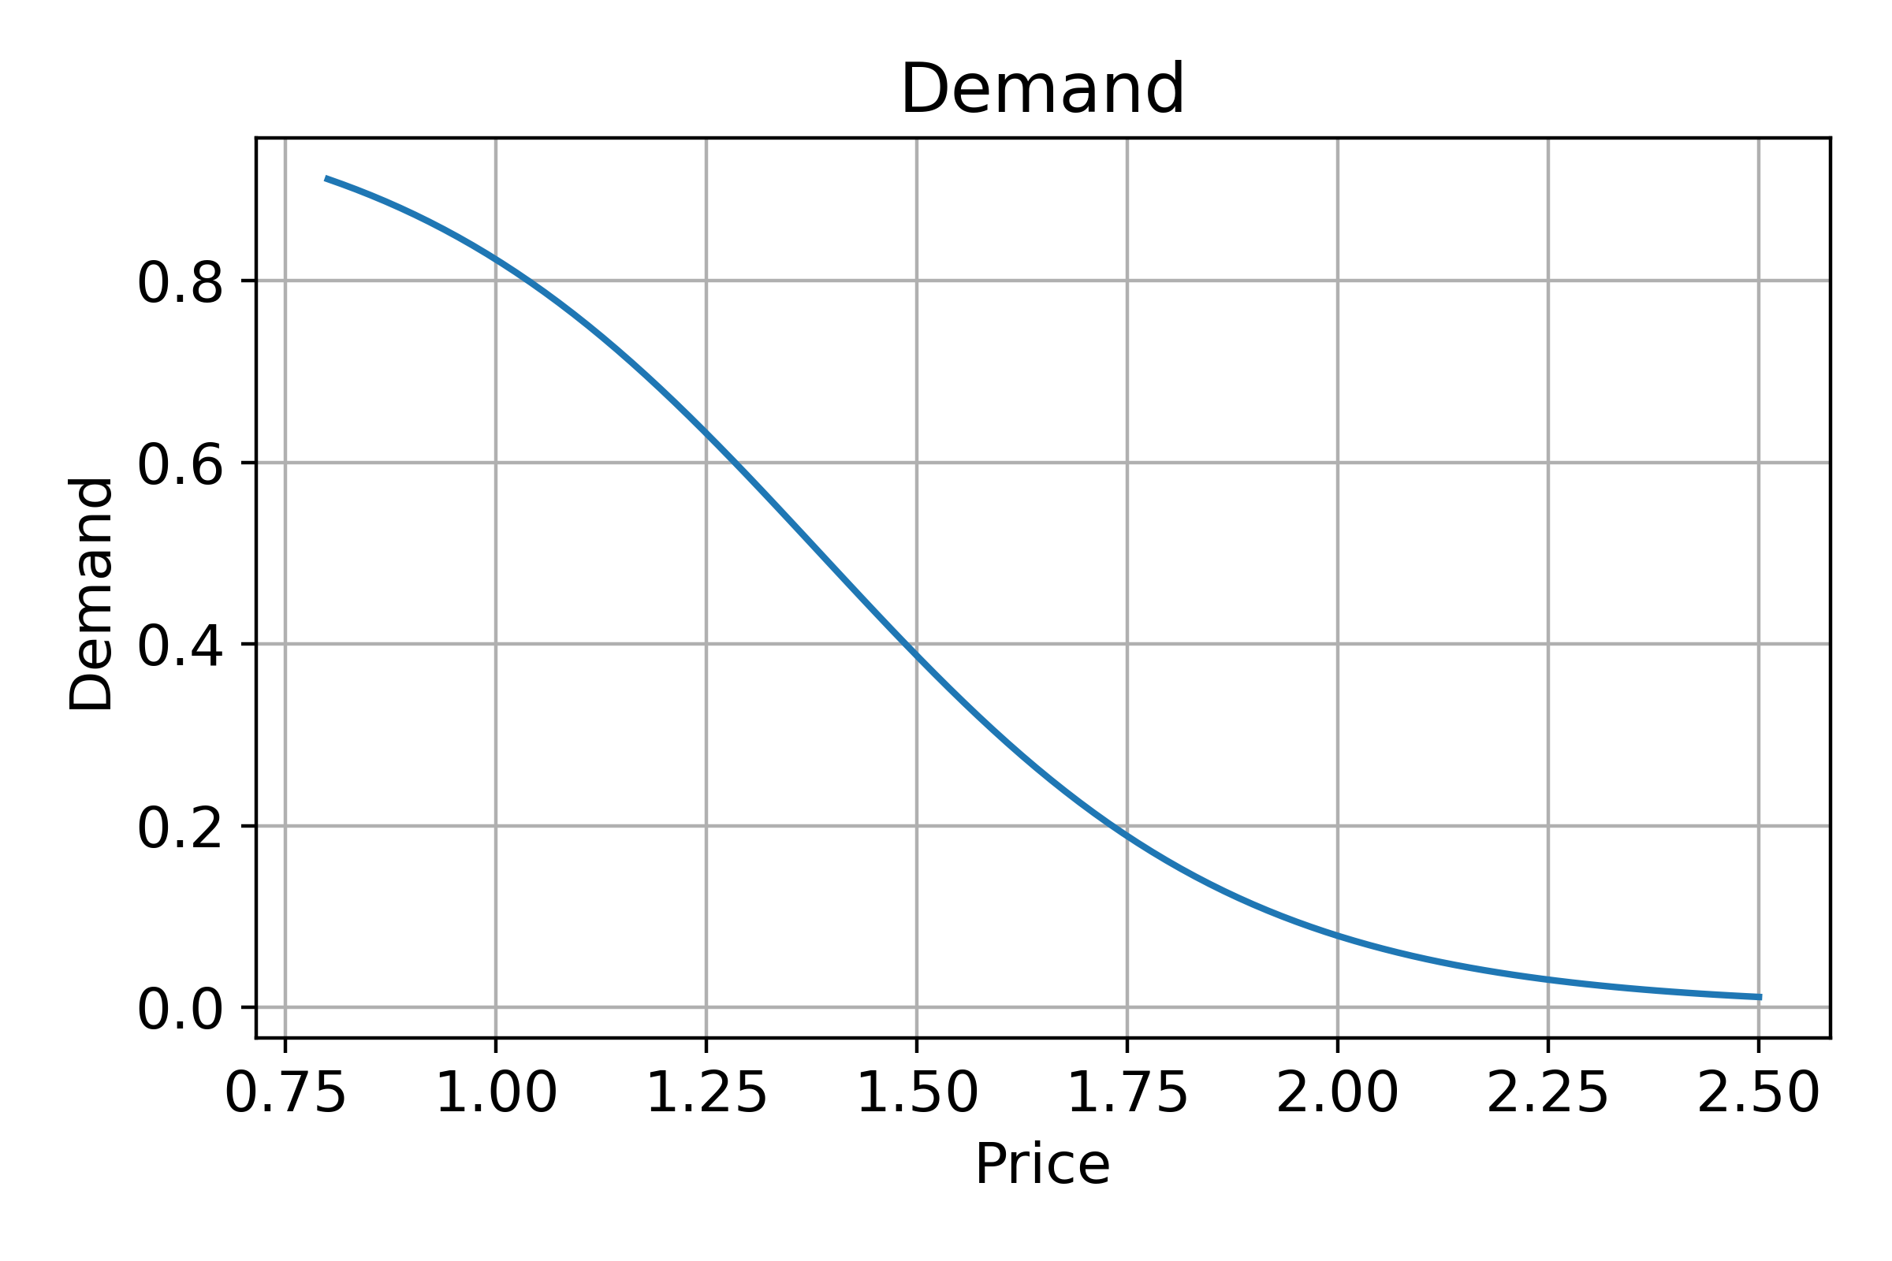
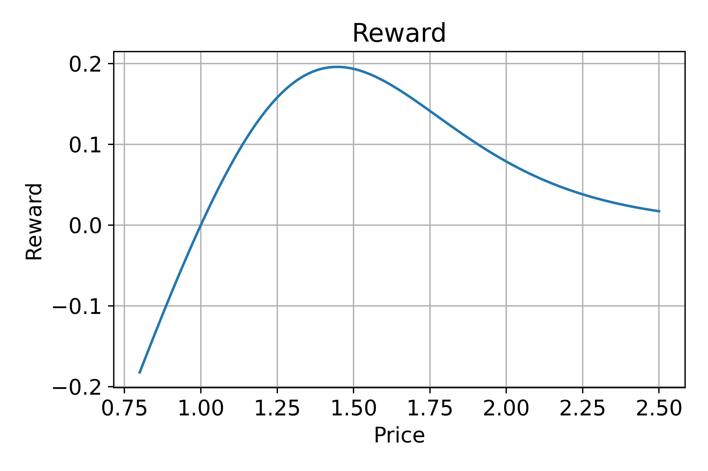
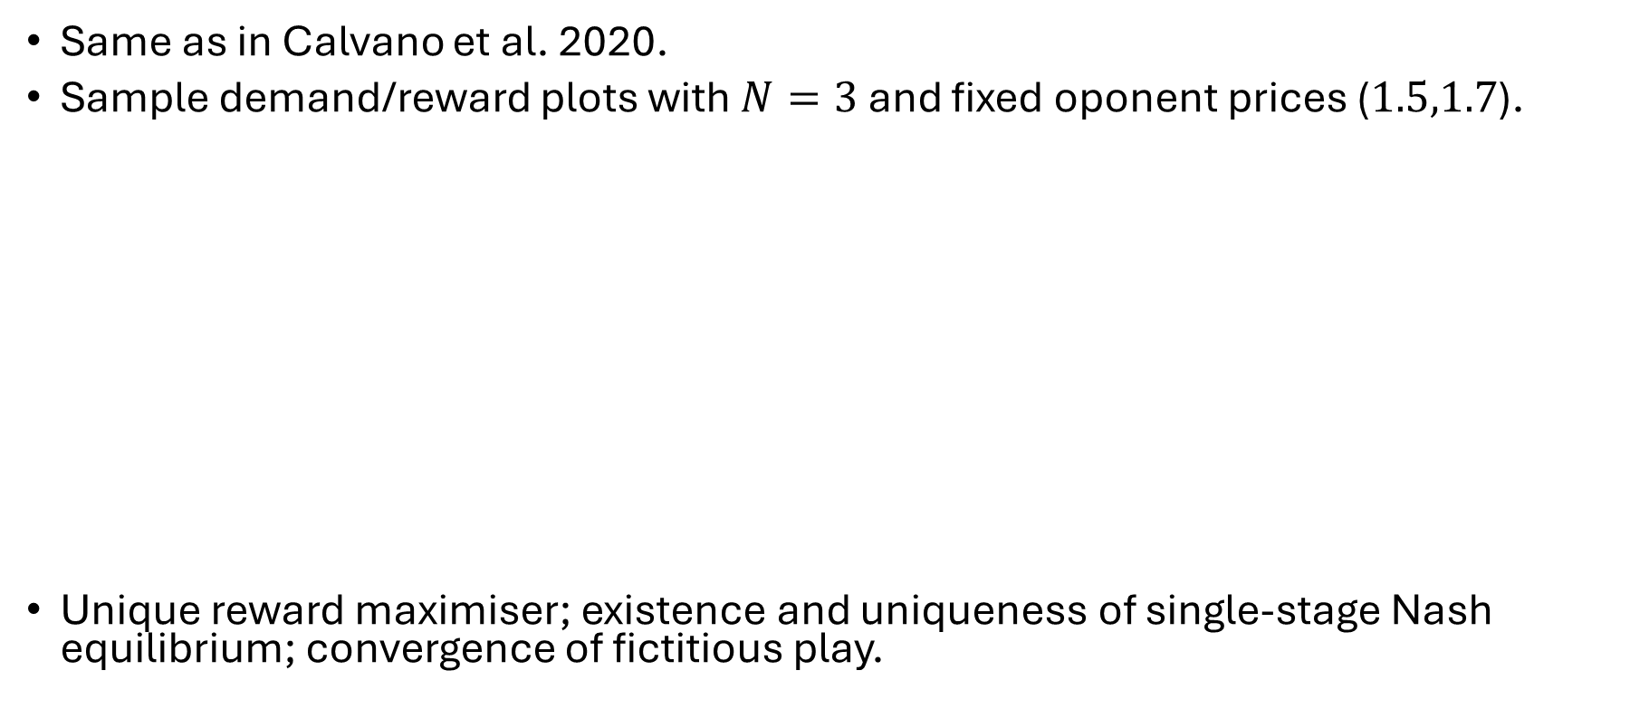
Environment with no delay (steady-state)
Same as in Calvano et al. 2020.
Sample demand/reward plots with $N=3$ and fixed oponent prices ($1.5,1.7$).
Unique reward maximiser; existence and uniqueness of single-stage Nash equilibrium; convergence of fictitious play.

Slide 22
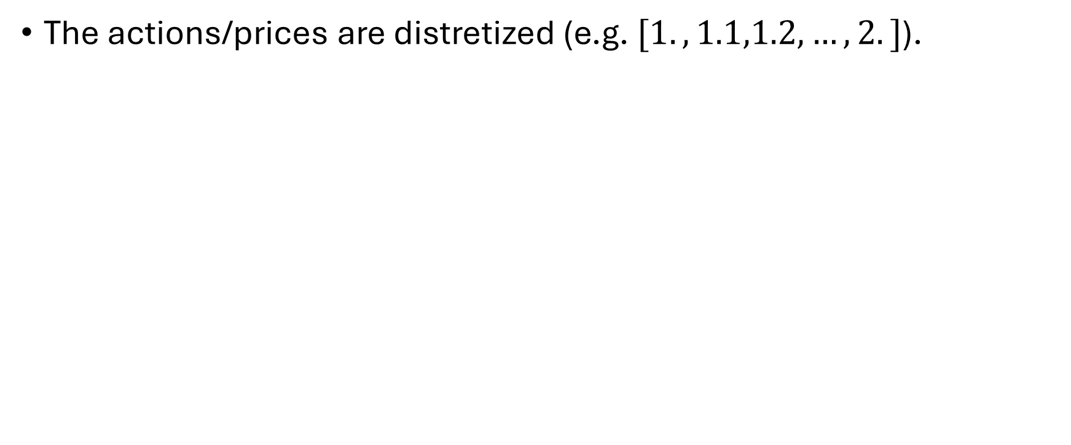
Algorithm
The actions/prices are distretized (e.g. $[1.,1.1,1.2,…,2.]$).

Slide 23
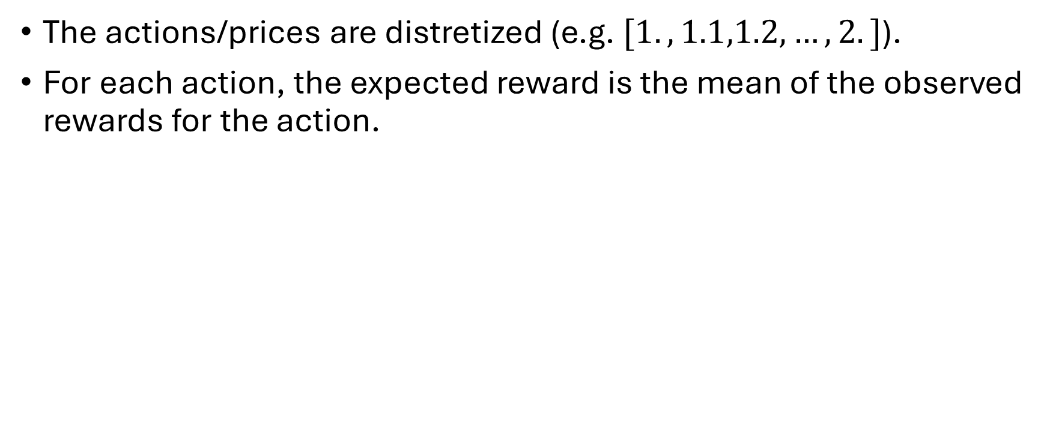
Algorithm
The actions/prices are distretized (e.g. $[1.,1.1,1.2,…,2.]$).
For each action, the expected reward is the mean of the observed rewards for the action.

Slide 24
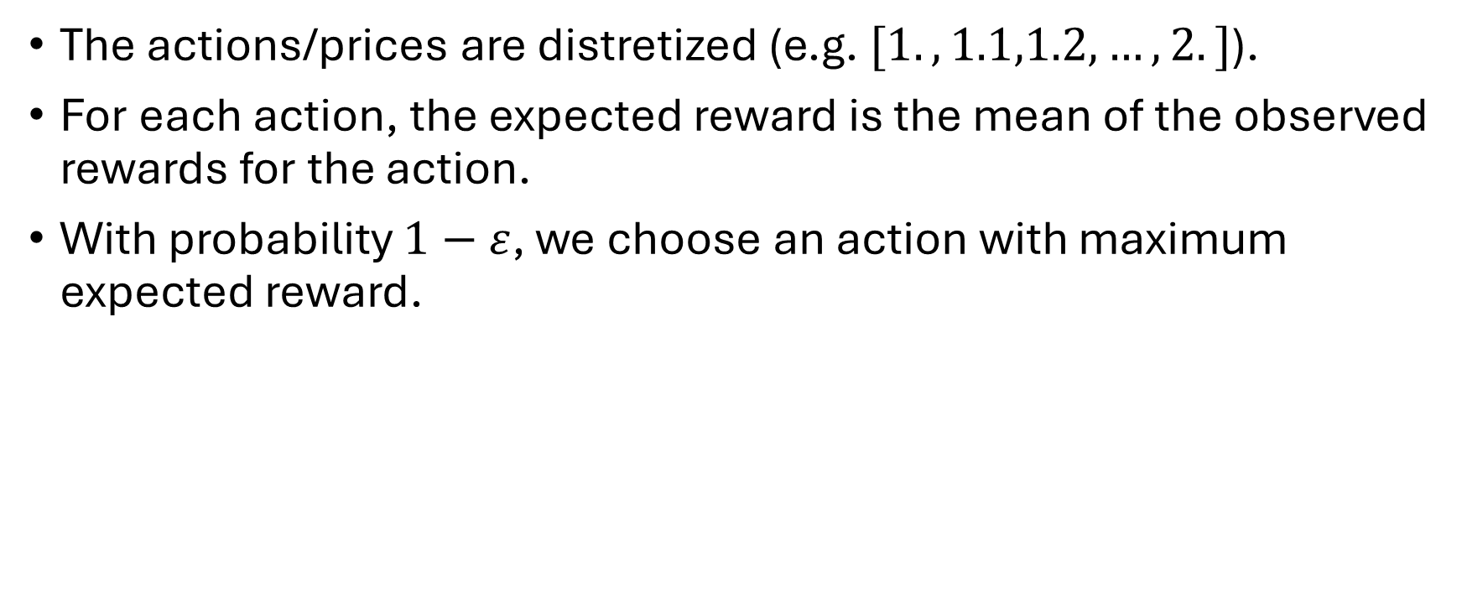
Algorithm
The actions/prices are distretized (e.g. $[1.,1.1,1.2,…,2.]$).
For each action, the expected reward is the mean of the observed rewards for the action.
With probability $1−ε$, we choose an action with maximum expected reward.

Slide 25
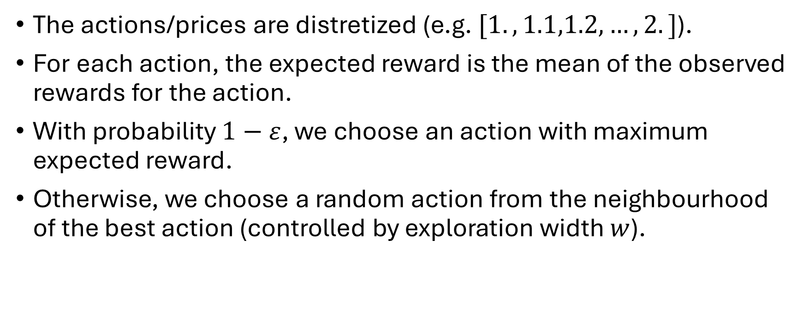
Algorithm
The actions/prices are distretized (e.g. $[1.,1.1,1.2,…,2.]$).
For each action, the expected reward is the mean of the observed rewards for the action.
With probability $1−ε$, we choose an action with maximum expected reward.
Otherwise, we choose a random action from the neighbourhood of the best action (controlled by exploration width $w$).

Slide 26
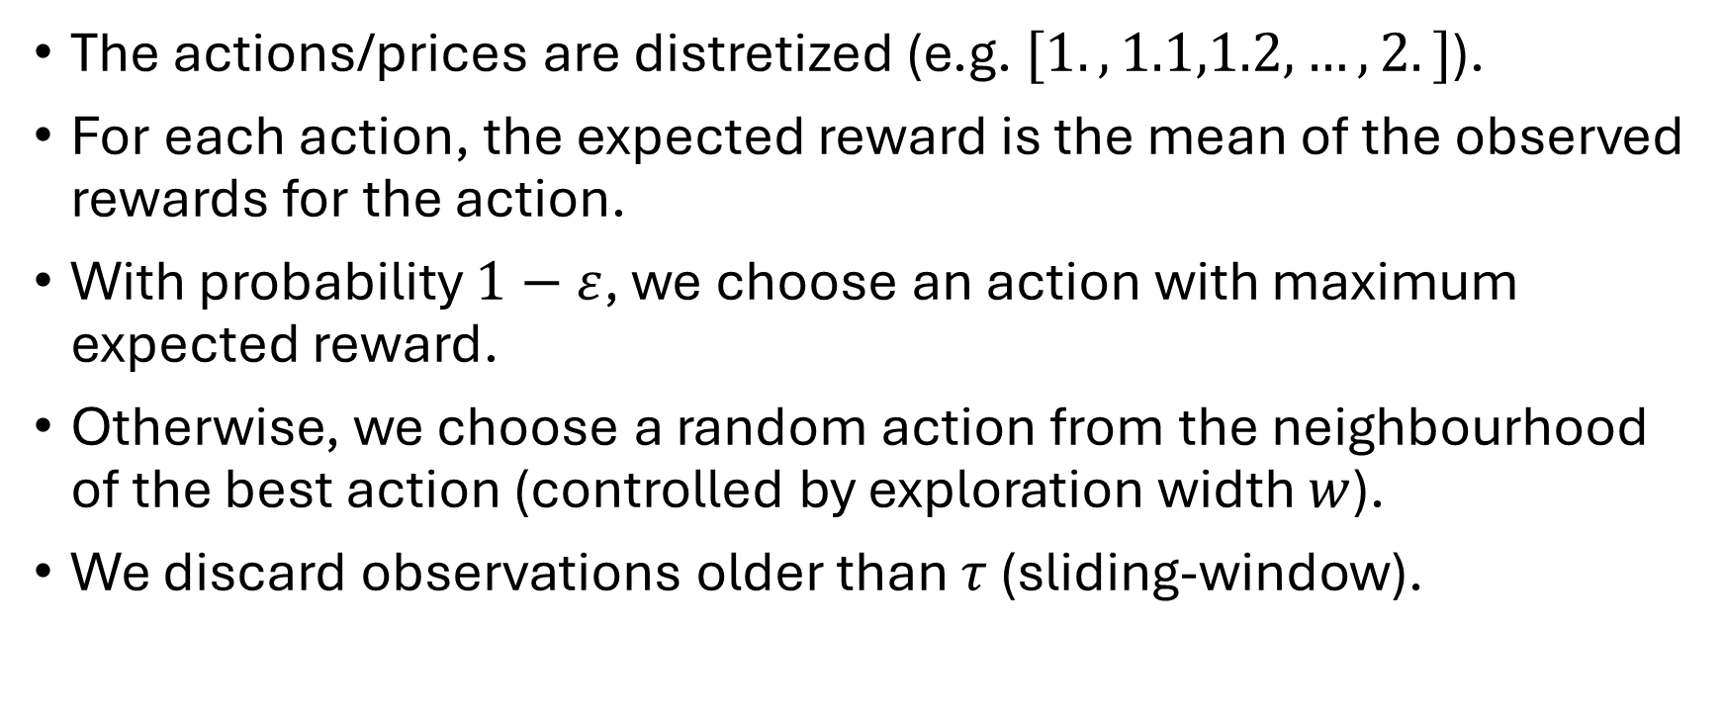
Algorithm
The actions/prices are distretized (e.g. $[1.,1.1,1.2,…,2.]$).
For each action, the expected reward is the mean of the observed rewards for the action.
With probability $1−ε$, we choose an action with maximum expected reward.
Otherwise, we choose a random action from the neighbourhood of the best action (controlled by exploration width $w$).
We discard observations older than $τ$ (sliding-window).

Slide 27
Algorithm - example

Slide 28
Algorithm - example

Slide 29
Algorithm - example

Slide 30
Algorithm - example

Slide 31
Algorithm - example

Slide 32
Algorithm - example

Slide 33
Algorithm - example

Slide 34
Algorithm - example

Slide 35
Algorithm - example

Slide 36
Algorithm - example

Slide 37
Algorithm - example

Slide 38
Algorithm
The algorithm is rational - in a stationary environment, the algorithm will converge to a local maximiser.

Slide 39
Algorithm
The algorithm is rational - in a stationary environment, the algorithm will converge to a local maximiser.
The algorithm results in small price variations.

Slide 40
Algorithm
The algorithm is rational - in a stationary environment, the algorithm will converge to a local maximiser.
The algorithm results in small price variations.
The algorithm adapts to changes in the environment.

Slide 41
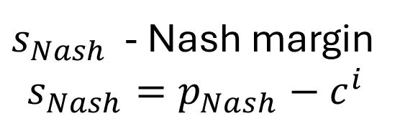
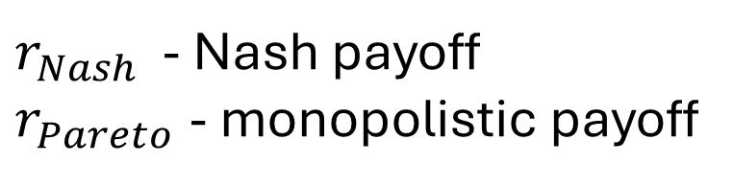
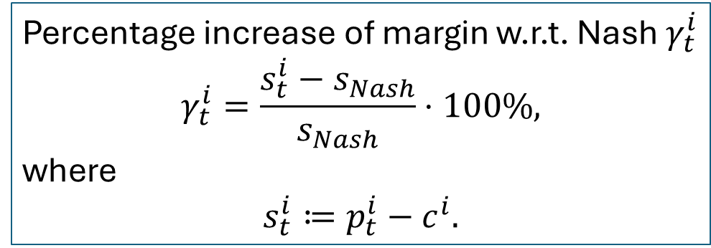
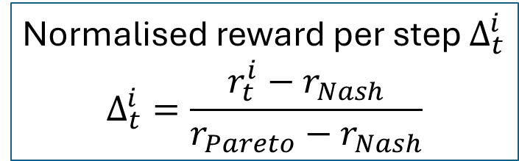
Results
Percentage increase of margin w.r.t. Nash $γ_{t}^{i}$
$$γ_{t}^{i}=\frac{s_{t}^{i}−s_{Nash}}{s_{Nash}}⋅100\%,$$
where
$$s_{t}^{i}≔p_{t}^{i}−c^{i}.$$
Normalised reward per step $Δ_{t}^{i}$
$$Δ_{t}^{i}=\frac{r_{t}^{i}−r_{Nash}}{r_{Pareto}−r_{Nash}}$$
$r_{Nash }$ - Nash payoff
$r_{Pareto}$ - monopolistic payoff
$s_{Nash }$ - Nash margin
$$s_{Nash}=p_{Nash}−c^{i}$$

Slide 42
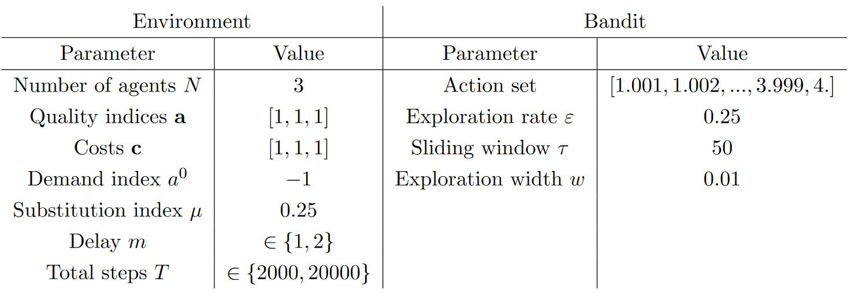
Results - baseline simulation parameters

Slide 43
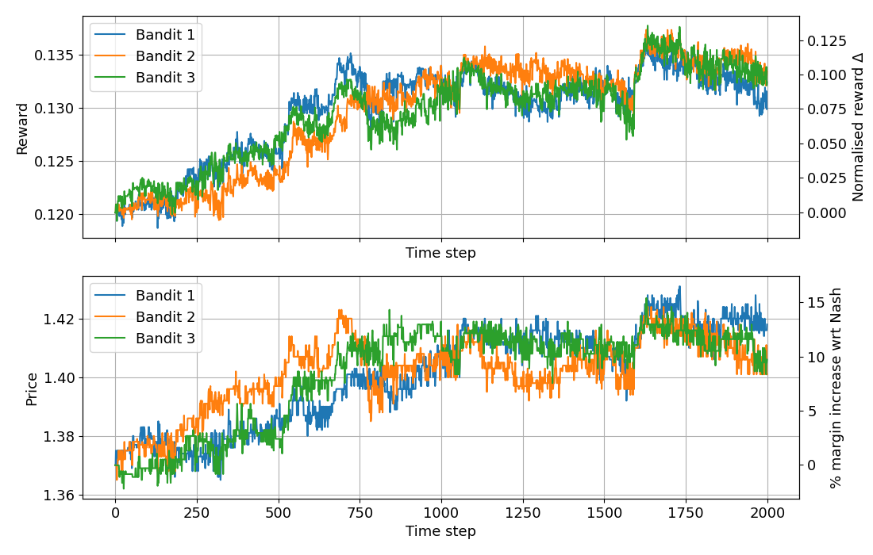
Baseline 3-agent simulation without delay

Slide 44
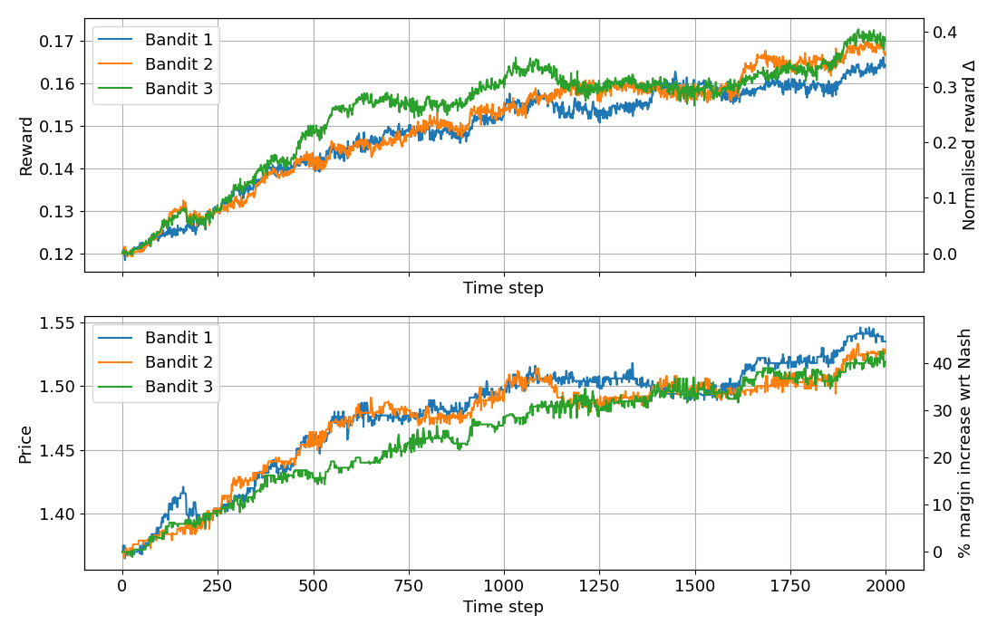
Baseline 3-agent simulation with delay

Slide 45
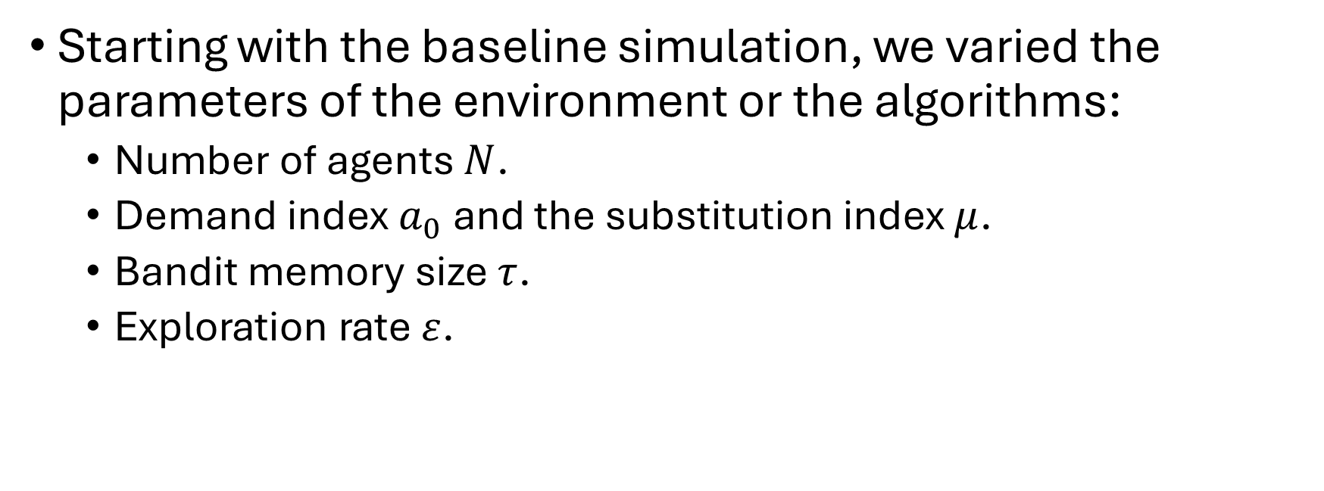
Results - Sensitivity Analysis
Starting with the baseline simulation, we varied the parameters of the environment or the algorithms:
  Number of agents $N$.
  Demand index $a_{0}$ and the substitution index $μ$.
  Bandit memory size $τ$.
  Exploration rate $ε$.

Slide 46
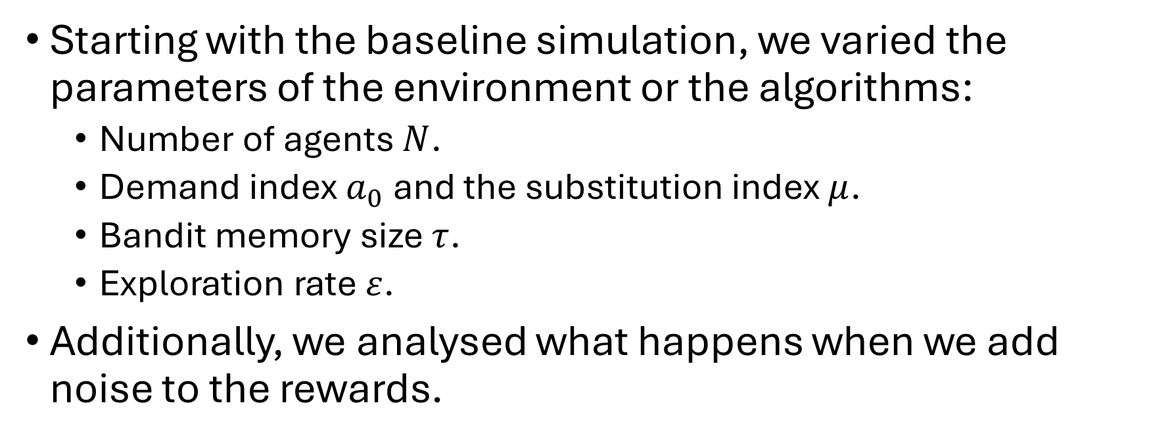
Results - Sensitivity Analysis
Starting with the baseline simulation, we varied the parameters of the environment or the algorithms:
  Number of agents $N$.
  Demand index $a_{0}$ and the substitution index $μ$.
  Bandit memory size $τ$.
  Exploration rate $ε$.
Additionally, we analysed what happens when we add noise to the rewards.

Slide 47
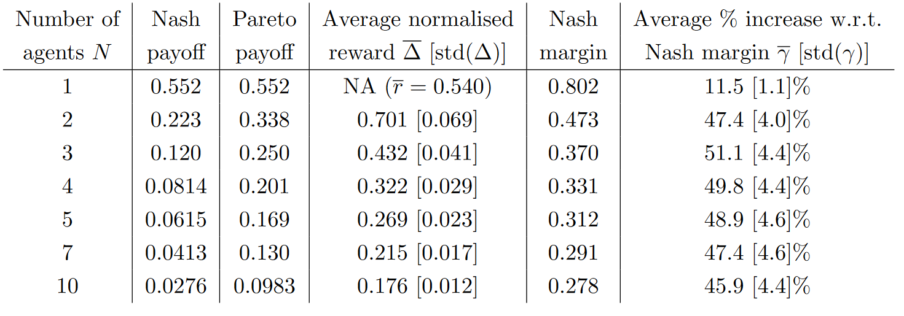
Increasing the number of agents does not prevent the pricing inefficiency due to transient demand response.

Slide 48
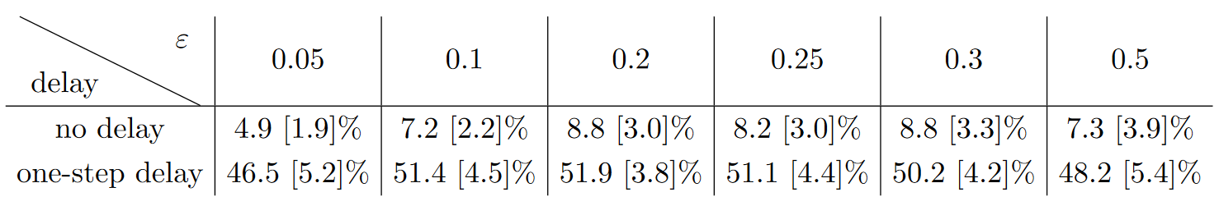

Moderate exploration $ε$ facilitates pseudo-collusion.
Average percentage increase of margin w.r.t. Nash $\overline{γ_{t}^{i}}$ $[std(γ_{t}^{i}$)]

Slide 49
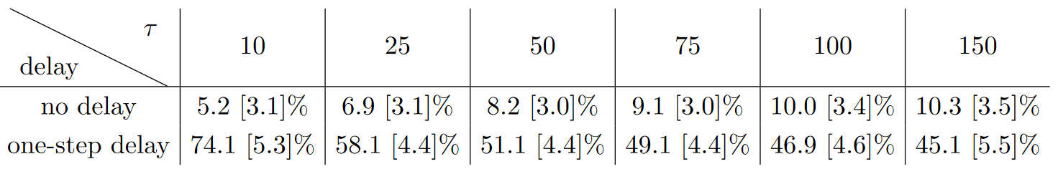
Increasing memory size alleviates effects of transient demad response but exacerbates collusion in no delay case.
Average percentage increase of margin w.r.t. Nash $\overline{γ_{t}^{i}}$ $[std(γ_{t}^{i}$)]

Slide 50
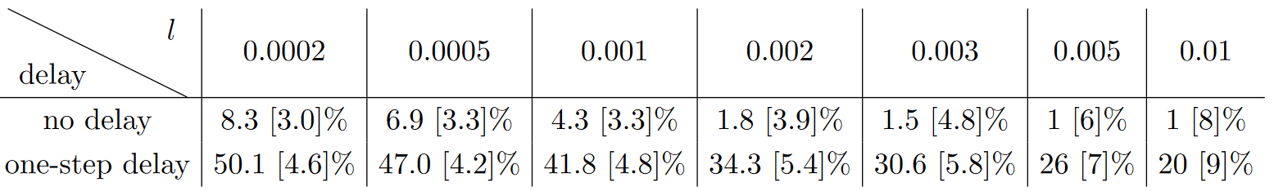
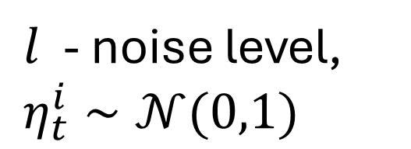

Noise decreases pricing inefficiency
$l$ - noise level,
$η_{t}^{i}∼𝒩(0,1)$
Reward: $r_{i}^{t}+lη_{i}^{t}$
Average percentage increase of margin w.r.t. Nash $\overline{γ_{t}^{i}}$ $[std(γ_{t}^{i}$)]

Slide 51
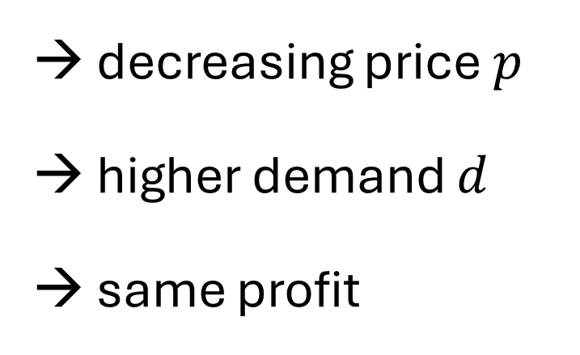
Discussion - why collusion with demand delay
No delay:
→ decreasing price $p$
higher demand $d$
same profit

Slide 52
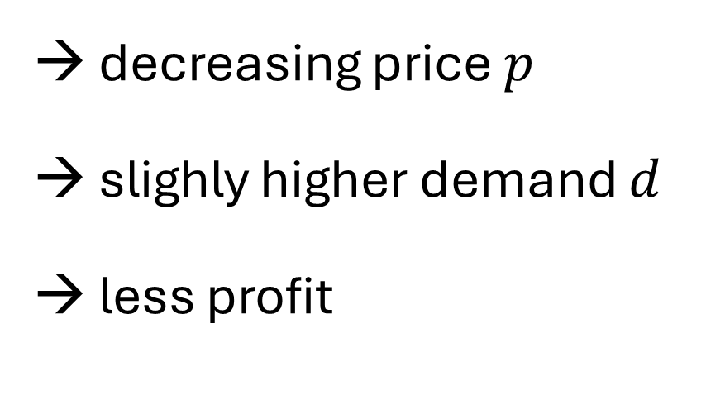
Discussion - why collusion with demand delay
No delay:
With delay:
→ decreasing price $p$
higher demand $d$
same profit
→ decreasing price $p$
slighly higher demand $d$
less profit

Slide 53
Discussion - why collusion with demand delay
No delay:
With delay:
→ decreasing price $p$
higher demand $d$
same profit
→ decreasing price $p$
slighly higher demand $d$
less profit
→ Keep the same price.

Slide 54
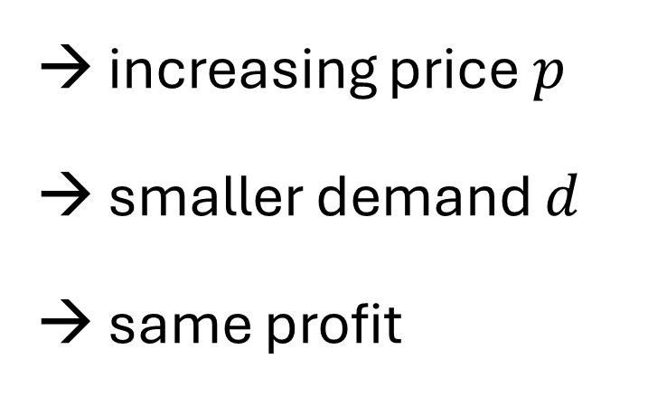
Discussion - why collusion with demand delay
No delay:
→ increasing price $p$
smaller demand $d$
same profit

Slide 55
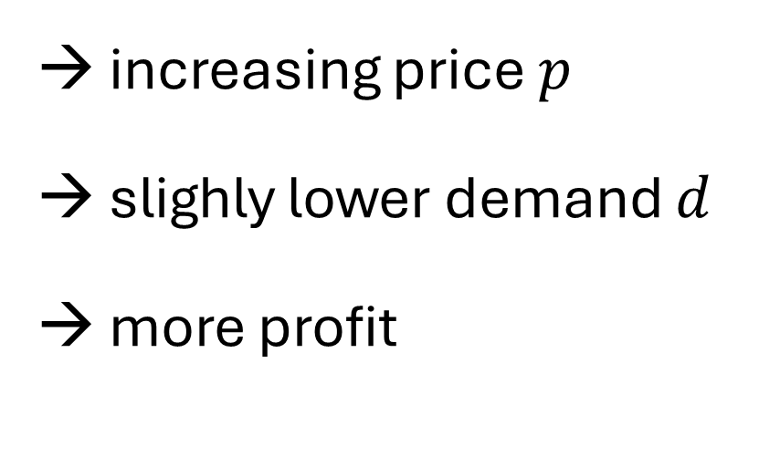
Discussion - why collusion with demand delay
No delay:
With delay:
→ increasing price $p$
smaller demand $d$
same profit
→ increasing price $p$
slighly lower demand $d$
more profit

Slide 56
Discussion - why collusion with demand delay
No delay:
With delay:
→ increasing price $p$
smaller demand $d$
same profit
→ increasing price $p$
slighly lower demand $d$
more profit
→ Increase the price.

Slide 57
Discussion - why collusion without delay
Moderate exploration favors price increases. In equilibrium:
One agent deviates → neither increase nor decrease the reward. no change

Slide 58
Discussion - why collusion without delay
Moderate exploration favors price increases. In equilibrium:
One agent deviates → neither increase nor decrease the reward. no change
Two agents decrease prices → both receive smaller rewards. no change

Slide 59
Discussion - why collusion without delay
Moderate exploration favors price increases. In equilibrium:
One agent deviates → neither increase nor decrease the reward. no change
Two agents decrease prices → both receive smaller rewards. no change
Two agents increase prices → both receive higher rewards. change

Slide 60
Discussion - why collusion without delay
Moderate exploration favors price increases. In equilibrium:
One agent deviates → neither increase nor decrease the reward. no change
Two agents decrease prices → both receive smaller rewards. no change
Two agents increase prices → both receive higher rewards. change
One increases/ one decreases → one higher, one lower rewards change

Slide 61
Discussion - why without delay
Past memory favors higher prices.
If the prices are high, the algorithm, through exploration, associates high prices with high rewards.

Slide 62
Discussion - why without delay
Past memory favors higher prices.
If the prices are high, the algorithm, through exploration, associates high prices with high rewards.
Then, one bandit decreases the price which causes the other bandits to decrease their prices.

Slide 63
Discussion - why without delay
Past memory favors higher prices.
If the prices are high, the algorithm, through exploration, associates high prices with high rewards.
Then, one bandit decreases the price which causes the other bandits to decrease their prices.
The observed rewards decrease.

Slide 64
Discussion - why without delay
Past memory favors higher prices.
If the prices are high, the algorithm, through exploration, associates high prices with high rewards.
Then, one bandit decreases the price which causes the other bandits to decrease their prices.
The observed rewards decrease.
The memory specifies that some previous (higher) prices were better.

Slide 65
Discussion - why without delay
Past memory favors higher prices.
If the prices are high, the algorithm, through exploration, associates high prices with high rewards.
Then, one bandit decreases the price which causes the other bandits to decrease their prices.
The observed rewards decrease.
The memory specifies that some previous (higher) prices were better.
The agents revert back to the higher prices.

Slide 66
Conclusions
1. Even without transient demand response, autonomous learning agents that cannot observe the competitor prices can converge to supra-competitive equilibrium.
2. When the transient demand response is introduced into the environment, the product margins can increase by 40% with respect to the competitive levels.

Slide 67
Thank you for the attention
Funding
Author is supported by the EPSRC Centre for Doctoral Training in Mathematical Modelling, Analysis and Computation (MAC-MIGS) funded by the UK Engineering and Physical Sciences Research Council (grant EP/S023291/1), Heriot-Watt University and the University of Edinburgh.

Slide 68
Future Work
Addition of memory i.e. Q-learning but with the restriction on the start up and exploration of the algorithm.
Addition of context (contextual bandits).

Slide 69
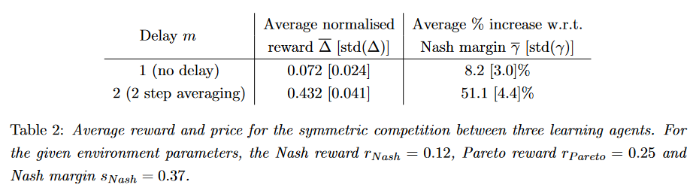
Additional materials

Slide 70
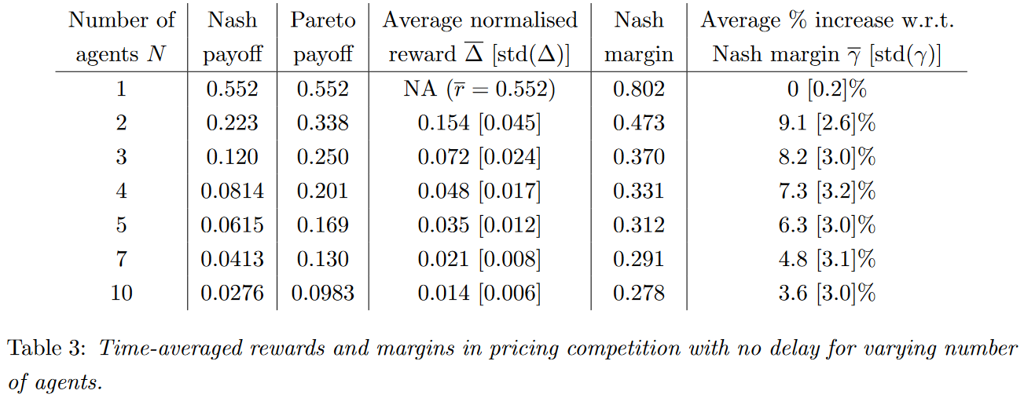
Additional materials

Slide 71
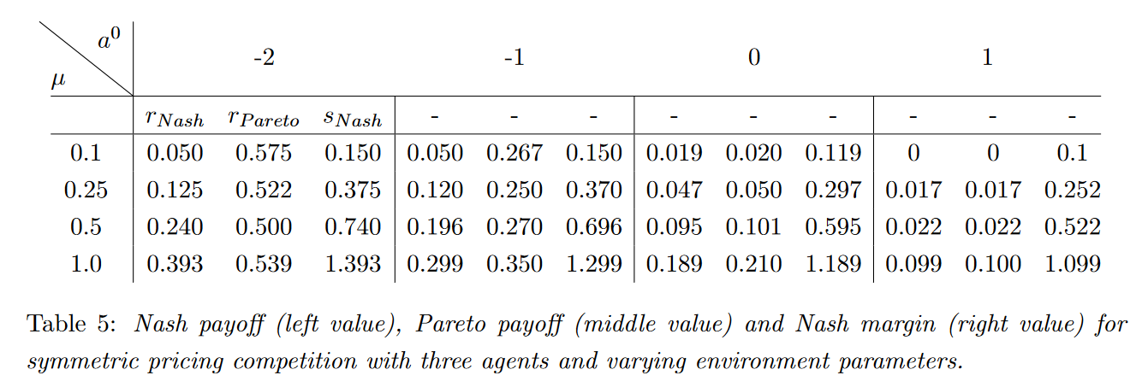
Additional materials

Slide 72
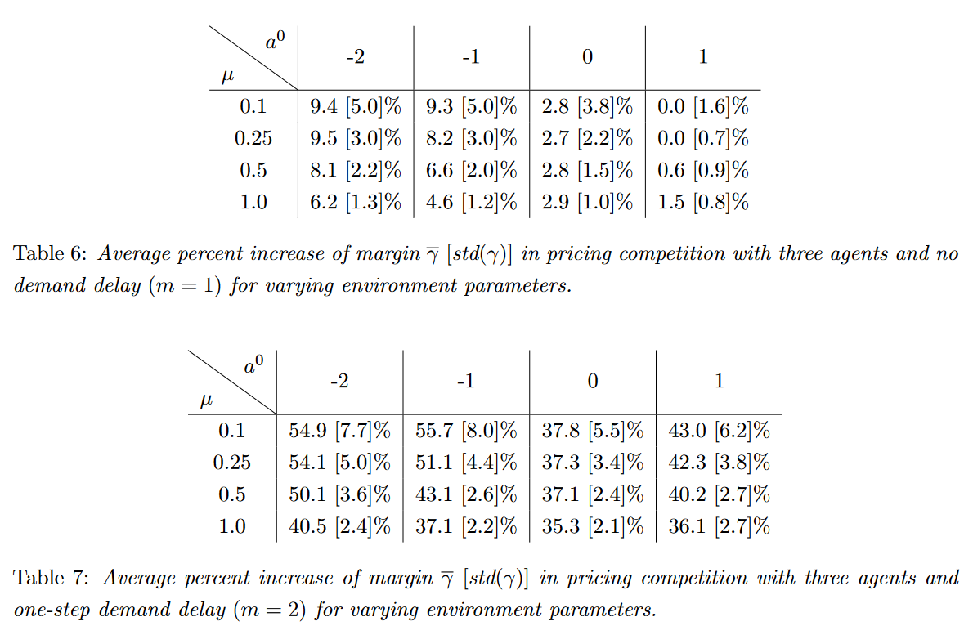
Additional materials

Slide 73
Additional materials

